Slide 1
Drought Legacy in Soil Microbiomes
Bin Wang
May 27th, 2020

Slide 2
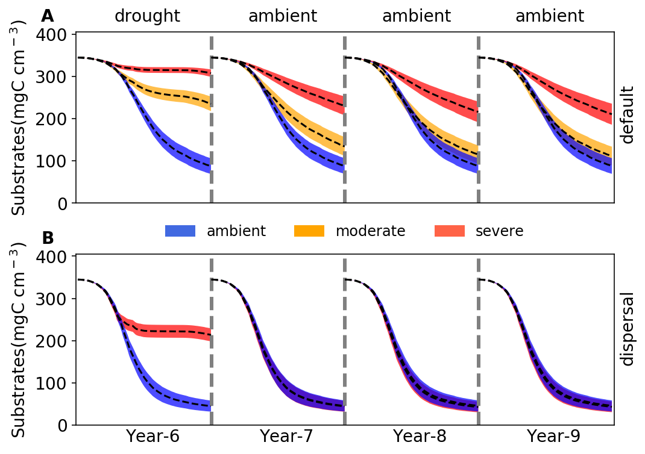
Drought Legacy in Litter Decomposition
Wang & Allison (in preparation)

Slide 3
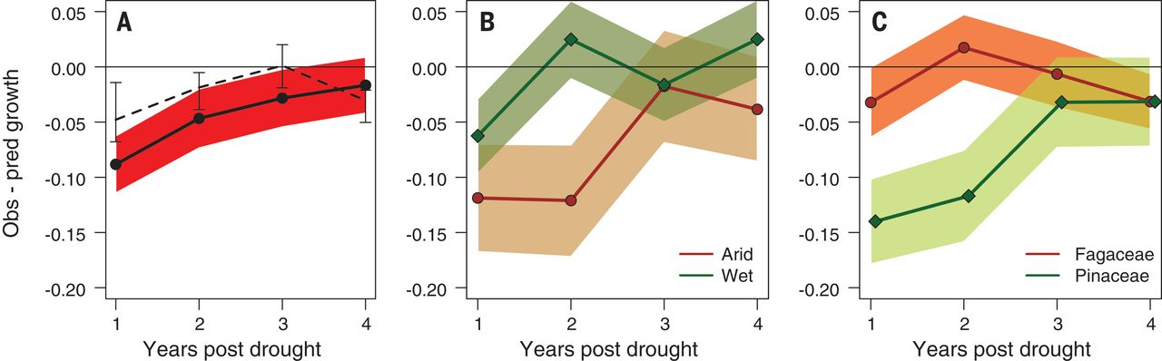
Missing Mechanisms in Soil Microbiome Drought Legacy
Martiny et al. 2017 The ISME
Anderegg et al. 2015 SCIENCE

Slide 4
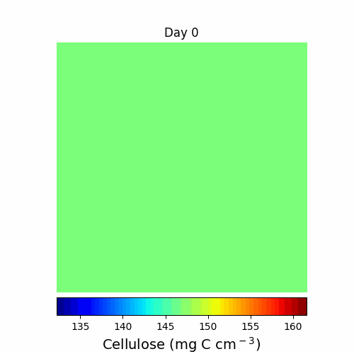
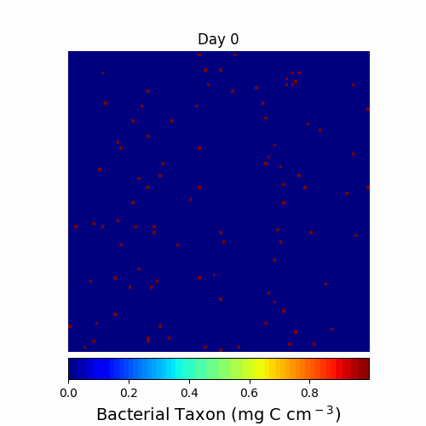

DEMENTpy
https://github.com/bioatmosphere/DEMENTpy

Slide 5
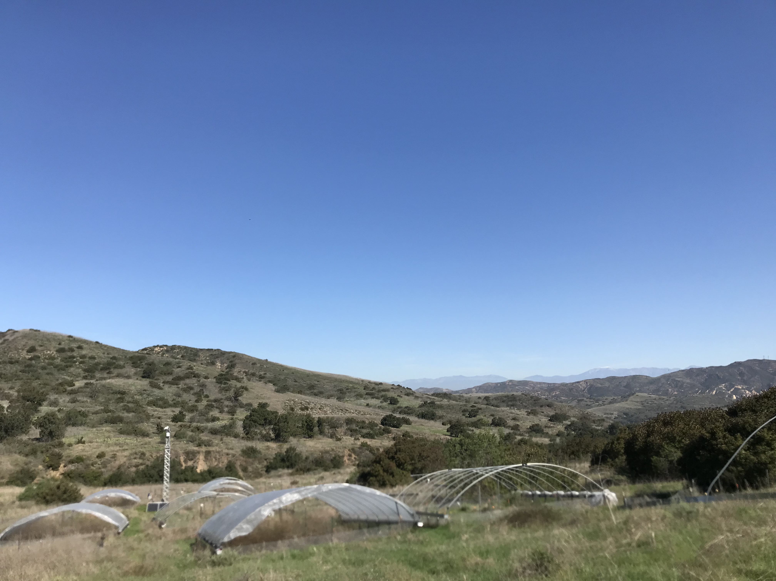
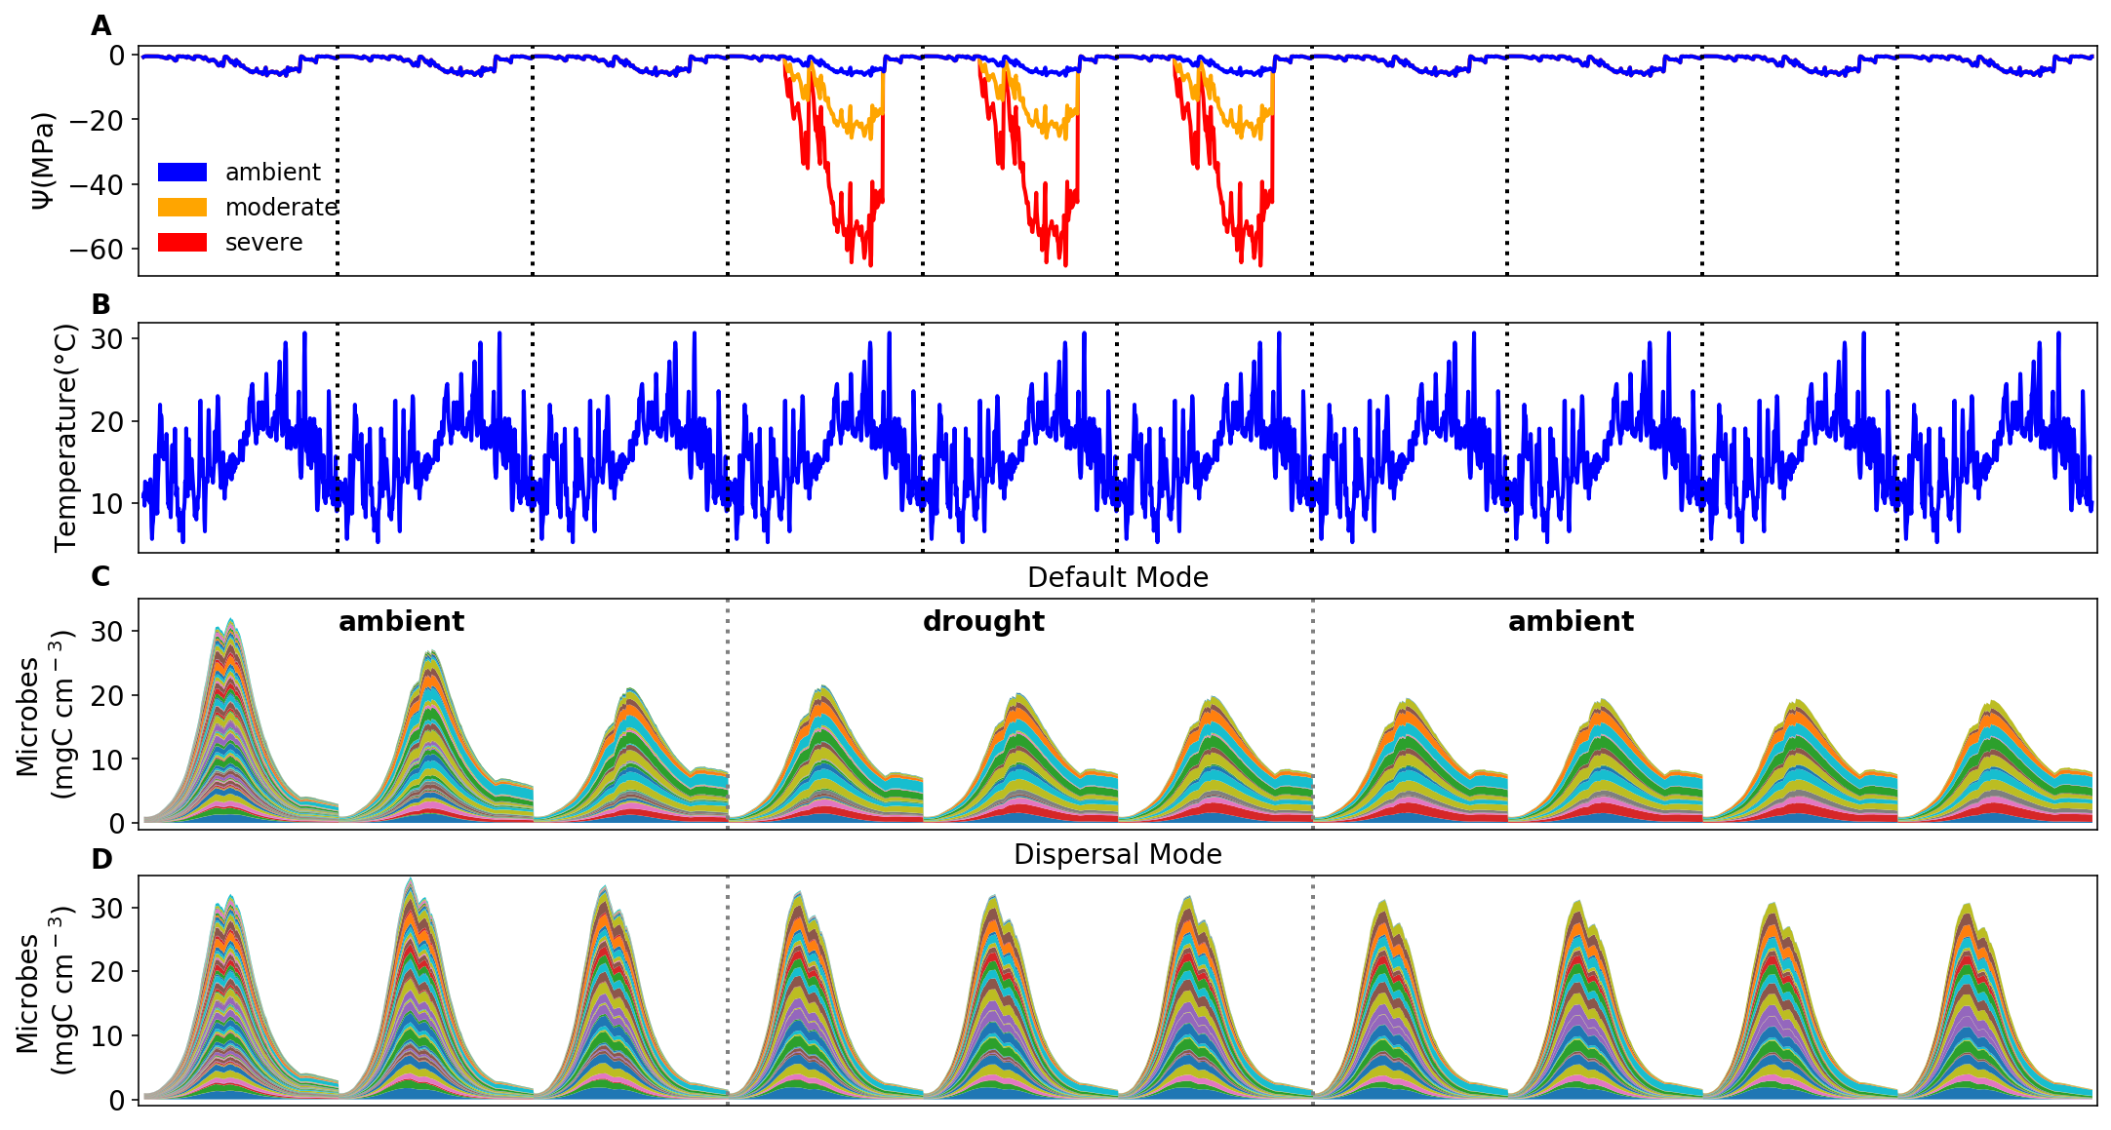
Simulations at Loma Ridge

Slide 6
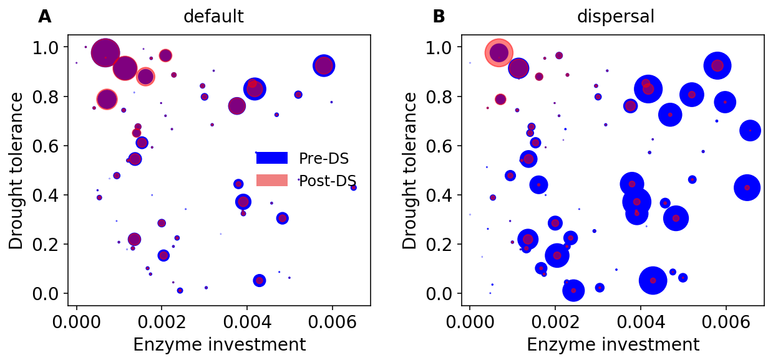
Drought-driven taxonomic shift toward more drought-tolerant ones across dry season

Slide 7
Community Changes under Moderate Drought

Slide 8
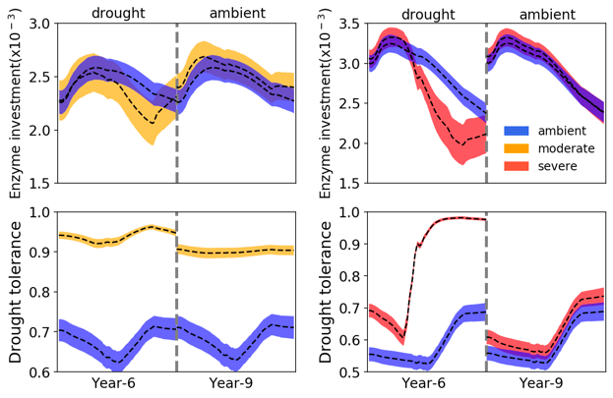
Community-level Traits and Resource Allocation

Slide 9
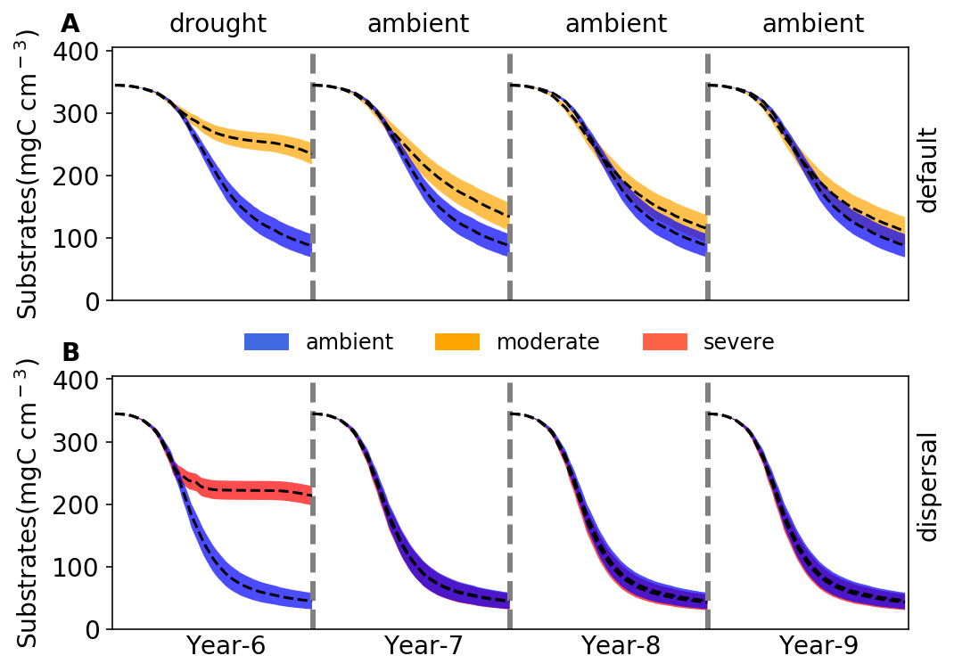
Transient Legacy under Moderate Drought

Slide 10
Community Dynamics under Severe Drought

Slide 11
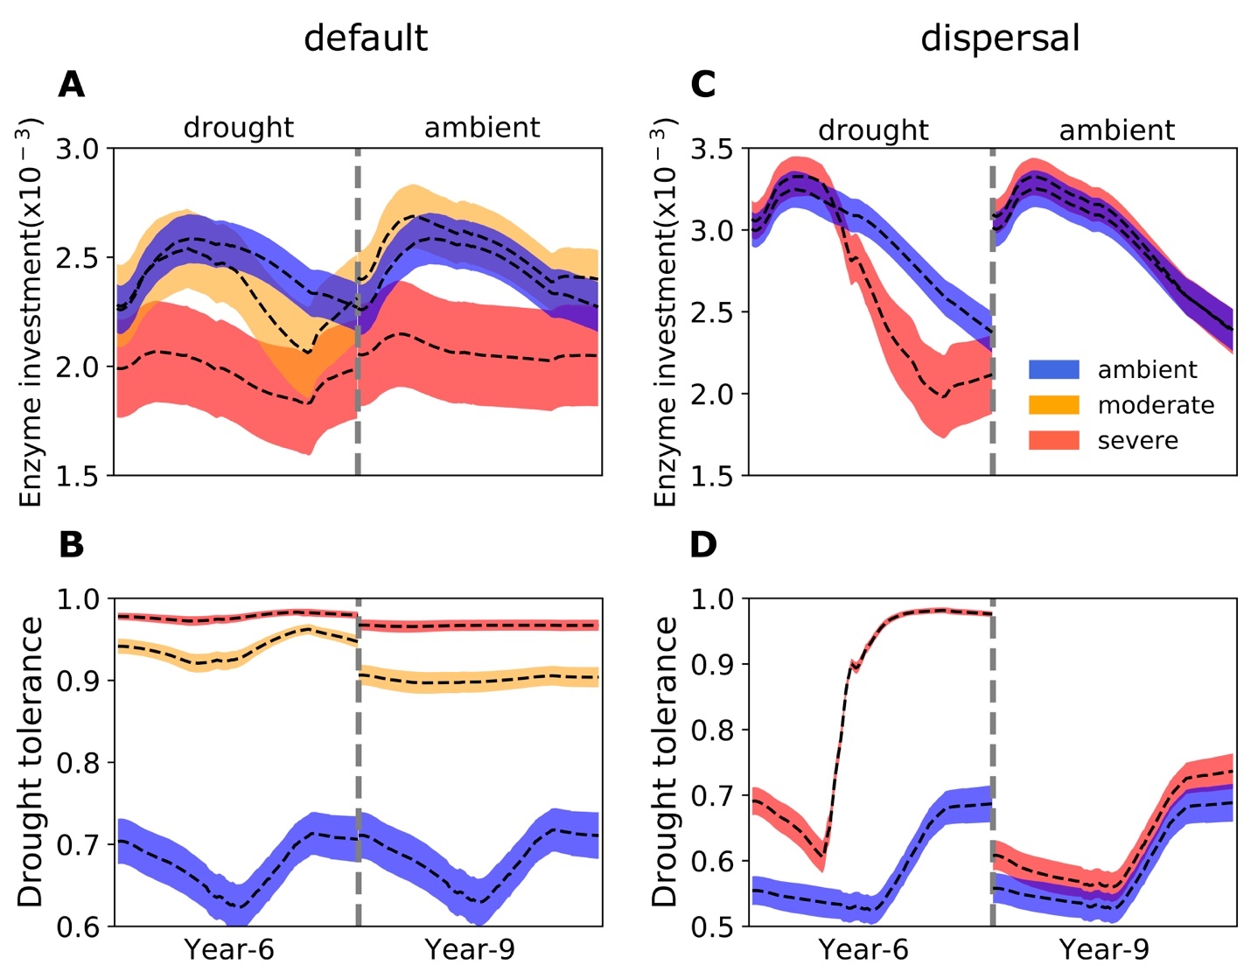
Persistent Legacy under Severe Drought

Slide 12
Drought legacy overwhelmed by dispersal

Slide 13
No changes in community-level traits

Slide 14
Resource allocation unchanged
Year 6
Year 9

Slide 15
No legacy in decomposition with dispersal

Slide 16
Drought legacy depends on community trajectory on the Y-A-S space

Slide 17
Tradeoff-mediated Legacy

